Slide 1
Sacraments of initiation
Baptism
Chrismation
Eucharist

Slide 2
Sacraments or mysteries?
In the mysterion of the church, the coming closer of men to God made possible, through their "cooperation" or "synergy"; to make this participation possible once more, is the goal of the incarnation.
Synergy, in general, may be defined as two things working together to produce a result not independently obtainable.

Slide 3
Holy Mysteries, the Church's entire life is one of sacrament.
In the mysteries, the Christian is united with God, becoming a partaker of the divine nature (II Peter 1:4).
With all the mysteries, God makes his presence known in his divine energies, using physical means to convey Himself to His people

Slide 4
St. Paul writes about the mysterion or mysteries that we eventually came to call the sacraments in the west. The Eastern Churches, we still keep the patristic tradition, and call them mysteries.
In the early days these mysteries included what came to be called the seven sacraments in the West. By the start of the Patristic period (2nd through 6th centuries) the sacramental action of the Church had developed into a rich series of rituals.

Slide 5
The early Fathers of the Church experienced the power of the Mysteries in their daily lives, and they saw its effects on the people who received them. Those who were baptized joined the community and their lives were changed. Through the Eucharist members of the community were strengthened for whatever lay ahead. Each of the mysteries, revealed the reality of God working in the world and continuing His saving mission. This experience led to the development of an understanding of mysteries as those events which transformed the recipient.

Slide 6
Our Christian life
The mysteries of initiation—Baptism, Confirmation, and Holy Communion—are the three primary mysteries, on which the rest of our life as a Christian depends. In the Eastern Church, all three mysteries are administered to infants at the same time.

Slide 7
The Mysteries disclose and reveal God to us, but also they serve to make us receptive to God.

Slide 8
What the fathers of the Church have said.
According to the Apostolic Canons, the priest baptizes the child in the name of the Father, and of the Son, and of the Holy Spirit, and anoints them with the Holy Myron. This is to take place only after renouncing Satan and professing Christ has been done.
Regarding the Sacrament of Chrismation, our Church Fathers have said :
“Whoever is baptized should be anointed by Chrism, to become the anointed for God, and so is granted the grace of the Holy Spirit” (St. Cyprian)
“We also, after getting out of the Baptismal Font are granted the anointment officially as was Christ, I mean the Holy Spirit” (St. Cyril of Jerusalem)
“After going out of the Baptismal water, we are anointed by Holy Oil according to old tradition. The anointment is accomplished externally on our bodies so that we may bear spiritual fruits” ( Tertullian)
“In the Sacrament of Baptism the body is cleansed, so that the soul may be purified, and in the Sacrament of Anointment the body is anointed so that the soul may be sanctified” ( Tertullian)

Slide 9
St Cyril of Alexandria
The catechumens were instructed immediately after they were initiated in the holy mysteries of Baptism, Confirmation, and the Eucharist, or because these sacraments are fully explained in them, which were never expounded to those who were not initiated, out of respect, and for fear of giving occasion to their profanation by the blasphemies of infidels

Slide 10
What is a Godparent?
Godfather/mother’ is a Syrian word meaning ‘guardian’, ‘caretaker’ or custodian. They are spiritually responsible before the church for bringing up the baptized child in a spiritual way, full of virtues of holiness, Christian discipline, and strong in the Orthodox faith. The Church puts also certain conditions for Godparents :

Slide 11
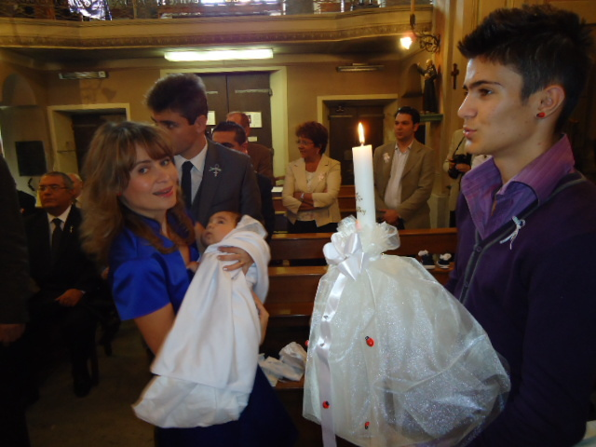

Slide 12
During the Liturgy or not?
Baptisms should be public, before the entire local parish, so that all the Christians can pray for the ones to be illumined, and may listen again to the vows that are made, remembering their own vows. It is good for every Christians to examine themselves during this time, to see whether he be “in Christ” or not, that is, whether he has kept the vows of their baptism.

Slide 13
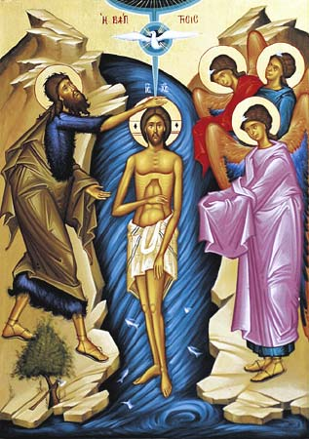
The Icon of the baptism of Christ

Slide 14
The naming of a child
This is normally done on the eighth day after birth.
Seven is the complete number in the bible.

Slide 15
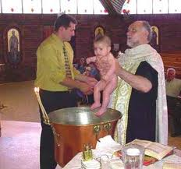
Baptism
Total immersion is a sign of being born again in Christ.

Slide 16
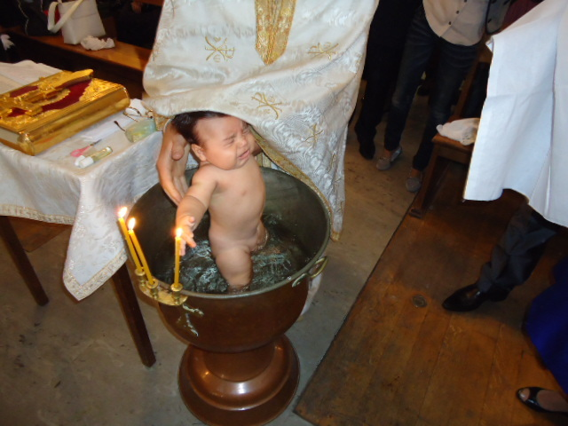

Slide 17
How is it done?
we from the Holy Apostles and Holy Fathers and the entire mind of the church that we always baptize by immersing three times in water, in the name of the Father, Son and Holy Spirit.
The proper belief concerning baptism is that it is the entry of the believer into the only, one, true, Holy, Catholic and Apostolic church.

Slide 18
Baptismal Garments. The garments brought by the godparent to dress the infant immediately after the immersion in Baptism. In Orthodoxy, these garments are considered sacred and must be either kept safely or destroyed by fire.
Baptismal Name. The individual's name given in baptism, commonly the name of a saint, who becomes the individual's Patron Saint. The baptismal names of the first-born are usually those of their grandparents.
Baptistry. A special room or area in the form a pool for baptizing in the ancient Church. Gradually it was replaced by the baptismal font
Baptismal font A large, often movable, circular basin on a stand, containing the water for immersion in Baptism. It symbolizes the Jordan River or the pool of Siloam.

Slide 19
Preparation for Baptism in the Church
· Baptismal Font with lukewarm water
· If indoors, under the Font, place a plastic sheet, and towels
· To the right of the Font, set on a table with a cloth cover:
· Two Candle Sticks
· The Holy Gospel Book
· Holy Chrism
· Anointing Oil (the "oil of gladness") in a bottle (to be blessed during the service)
· Anointing brush (for the chrismation)
· Sponge in a bowl of water.
· Baptismal Candle(s)
· Baptismal cross(es)
· Close at hand should be:
· Towel
· Baptismal Garment

Slide 20
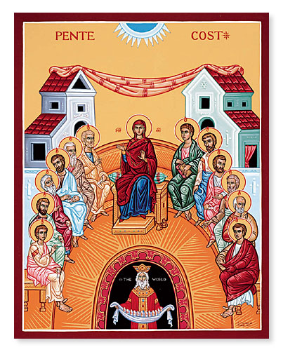
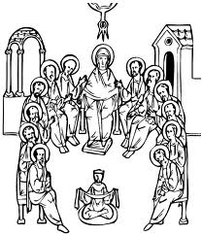
Chrismation is linked to Pentecost

Slide 21
Chrismation
Chrismation is administered at the same time as baptism.
Just as Easter has no meaning for the world without Pentecost, so baptism has no meaning for the Christian without chrismation.

Slide 22
. Chrismation is the second sacrament which bestows upon us the Holy Spirit. Holy Communion is the sacrament of receiving the resurrected body and blood of Jesus Christ.

Slide 23
Through Chrismation every member of the Church becomes a prophet, and receives a share in the royal priesthood of Christ; all Christians alike, because they are chrismated, are called to act as conscious witnesses to the Truth. 'You have an anointing from the Holy One, and know all things' (I John 2:20)

Slide 24
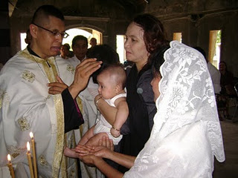
Chrismation

Slide 25
The oil
The oil used has over 65 different ingredients.
To make it is a complicated process. You begin to “cook” the oil on the Tuesday of Holy week. While saying the prayers you leave it to cook continuously till the Thursday of Holy week. You add the different ingredients in a prescribed order. On Thursday the oil is taken out and put in a container that is then put on the altar and blessed. The oil stays on the altar till Easter Monday.

Slide 26
Chrismation
The sacrament of chrismation is an extension of the day of Pentecost, on which the Holy Spirit was poured out on the Apostles. It is by Chrismation that a person becomes a layperson—a member of the laos, the people of God.
The Christian is anointed with this oil in the sign of the Cross on his forehead, eyes, nostrils, mouth, ears, chest, hands and feet. Each time, the priest administering the sacrament says, "The Seal and Gift of the Holy Spirit."

Slide 27
The symbolism of Chrismation
The anointing of the forehead signifies the sanctification of the mind, or thoughts.
The anointing of the chest signifies the sanctification of the heart, or desires.
The anointing of the eyes, ears, lips signifies the sanctification of the senses.
The anointing of the hands and feet signifies their sanctification to good works and the walk in the way of His commandments.

Slide 28
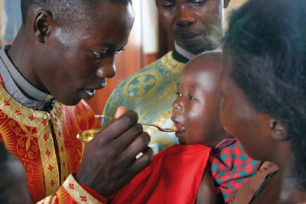
Eucharist

Slide 29
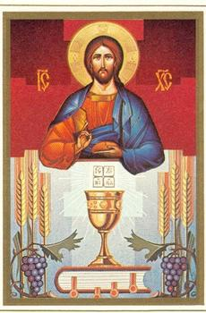
Christ and Eucharist icon

Slide 30
Chrismation is followed by the Eucharist. This means that in the babies and children are fully communicant members of the Church.

Slide 31
The newly baptised Christian is now a layperson, a full member of the people of God (the 'Royal Priesthood'). All Christians are called to be witnesses to the Truth.

Slide 32
The ritual
Making of a catechumen and exorcisms
· The person who desire illumination and the Godparents stand at the entrance to the church, facing east. The altar must always face the East.
· Prayer for those who wish to be illumined.
· Four exorcism prayers.
· Questioning of those who wish to be illumined, with the renouncing of Satan and the reciting of the Symbol of Faith (three times)
· Prayer for the professed catechumens.

Slide 33
Baptism and Chrismation Service
· Censing of the font occurs immediately before the service.
· Blessing - “Blessed is the Kingdom...”
· Great Litany with prayers for the blessing of the water and the person(s) who desire illumination.
· Prayers and blessing of the baptismal water.
· Prayers and blessing of the oil of anointing (oil of gladness).
· Anointing with the oil of gladness.
· Face
· Breast
· Upper back
· Hands
· Feet

Slide 34
· Baptism
· Robing of the newly-baptized in the baptismal garment (during the singing of Psalm 31)
· Prayer for the newly baptized.
· Chrismation of the newly-baptized. “The seal of the gift of the Holy Spirit…”
· Anointing of the:
· brow
· eyes
· nostrils
· lips
· ears
· hands
· feet

Slide 35
· Procession of the newly-illumined and sponsors around the font (3 times) while “As many have been baptized” is sung.
Giving Godparents a candle
· Prokeimen
· Epistle of the Holy Apostle Paul to the Romans (6:3-11)
· Alleluia (sung 3 times)
· Holy Gospel according to St. Matthew (28:16-20)
· Ektenia
· ·
· Fervent Ektenia

