Slide 1

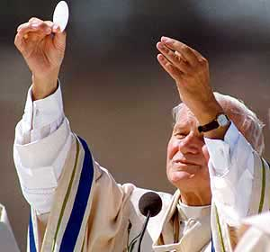
SOME SPIRITUAL REFLECTIONS
ON THE RITE OF THE MASS
(A FEW SELECTED RITUAL MOMENTS)
彌撒儀式的一些靈修反省
Fr. Joy Perera
施喜樂神父
2012年2月15日

Slide 2
What is a rite? 儀式是什麼？
The word RITE comes from the root R’thm
Which has both a Greek and an Indian Rig Vedic origin.
In both cases it refers to Order.
Hence, where there is ritual, there is order.
儀式「RITE 」一字，來自希臘文R’thm及印度詞Rig Vedic
兩者都指「秩序」 Order ；
即是說：有儀式，便有秩序。

Slide 3
What is a rite? 儀式是什麼？
A rite basically has four characteristic features:
Consensus of opinion
Stability
Repetition
Symbolism
Religious rites have additional features
Memorial
Consecration
儀式有四項基本特徵：
有共識的意見
穩定
重複
象徵意義
宗教儀式增添兩項特徵：
紀念
祝聖

Slide 4
Features of the Roman Rite 羅馬禮的特色
BREVITY
SOLEMNITY
SOBRIETY
HEAD-CENTRALITY
簡短
莊嚴
節制(冷靜)
理性

Slide 5
Why do we need a ritual for the Mass?
為什麼彌撒需要有儀式？
Read: Luke 22, 7-13
路22:7-13
⁷ 無酵節日到了，這一天，應宰殺逾越節羔羊。
⁸ 耶穌打發伯多祿和若望說：「你們去為我們預備要吃的逾越節晚餐吧！」
⁹ 他們問他說：「你願意我們在那裡預備？」
¹⁰ 他回答說：「你們進城，必會看見一個拿水罐的人，迎面而來，你們就跟著他，到他所進的那一家，
¹¹ 對那家的主人說：師父問你：我同我的門徒吃逾越節晚餐的客房在那裡？
¹² 那人必指給你們一間鋪設好了的寬大樓廳；你們就在那裡準備。」
¹³ 他們去了，所遇見的，正如耶穌對他們所說的一樣；他們便預備了逾越節晚餐。

Slide 6
Why do we need a ritual for the Mass?
為什麼彌撒需要有儀式？
Read: Luke 22, 7-13
Jesus selected,
A special place
A special group of participants
A special ritualistic context
for His Last Supper…
讀路22:7-13
耶穌為他的最後晚餐，挑選了：
一個特別的地點
一群特別的參加者
一個特別的儀式背景

Slide 7
We will take a few ritual moments for our reflection…
我們取一些儀式時刻來做反省：
From the Gatherings rites:
Entrance Procession
Sign of the Cross
Greeting
Penitential Rituals
From the Liturgy of the Word:
The structure of the Liturgy of the Word
Gospel Proclamation
開始儀式：
進堂遊行
劃十字聖號
致候
懺悔禮
聖道禮儀
聖道禮儀的結構
福音遊行

Slide 8
We will take a few ritual moments for our reflection…
我們取一些儀式時刻來做反省：
From Preparation of the Altar:
Preparation of the gifts
From the Liturgy of the Eucharist:
The Eucharistic Prayer
Breaking of the Bread
預備祭台
預備禮品
聖祭禮儀
感恩經
擘餅

Slide 9
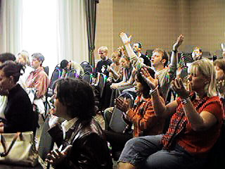
SPIRITUALITY OF THE EUCHARISTIC LITURGY
感恩祭禮儀靈修
THE GATHERING RITES
聚集儀式
What are GATHERING RITES?
They are what we do from the time of the entrance procession/entrance hymn until the Opening Prayer.
The objective of these rites is
to Gather the people of God
so that they may worthily be nourished by the Word of God and the Bread of Life in order to go and proclaim the Good News to others.
什麼是聚集儀式？
就是由進堂遊行／進堂詠至
集禱經之間，我們所做的。
這些儀式的目標，是聚集天主子民，好讓他們能堪當地得到天主聖言和生命之糧的滋養，以及向其他人宣布喜訊。

Slide 10
SPIRITUALITY OF THE EUCHARISTIC LITURGY
感恩祭禮儀靈修
THE GATHERING RITES
聚集儀式
We list them out as follows:
The entrance procession/ entrance hymn
- Signs of reverence
- Sign of the Cross
- Greeting
Penitential ritual
Short Christological Litany
- Gloria
Opening Prayer
－進堂遊行／
進堂詠
－（向祭台）致敬
－劃十字聖號
－致候
－懺悔禮
－簡短向基督呼救的禱文
－光榮頌
－集禱經

Slide 11
Entrance Procession
進堂遊行
Why do we go in processions?
What is the difference between Christian processions and many other religious processions?
What is the theological significance of an entrance procession?
為什麼遊行進堂？
基督徒遊行跟
其他宗教的遊行有什麼分別？
進堂遊行有何神學意義？

Slide 12
Entrance Procession
進堂遊行
There was no entrance procession in the first century ritual of the breaking of the Bread.
Why?
When did we start an entrance procession like the one we have today?
第一世紀的擘餅禮並沒有進堂遊行。
為什麼？
我們何時開始有好像今天的進堂遊行？

Slide 13
Entrance Procession
進堂遊行
It is in the middle of the fourth century.
What is the biblical foundation for processions in the Old Testament?
進堂遊行是始自四世紀中葉。
遊行在舊約的聖經基礎是什麼？

Slide 14
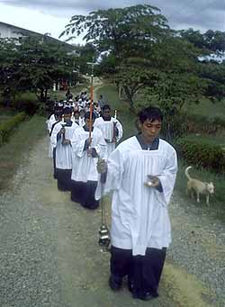
SPIRITUALITY OF THE EUCHARISTIC LITURGY
感恩祭禮儀靈修
ENTRANCE PROCESSION
進堂遊行
Historical Information
There would have been no possibility of having entrance processions during the first three centuries when the breaking of bread was predominantly a domestic liturgy.
Processions began by mid fourth century especially when basilicas were converted into churches.
歷史資料
一至三世紀，擘餅禮以家庭禮儀為主，不可能有進堂遊行。
遊行始於四世紀中葉，尤其當(羅馬)會堂(basilica)被改裝為聖堂。

Slide 15
SPIRITUALITY OF THE EUCHARISTIC LITURGY
感恩祭禮儀靈修
ENTRANCE PROCESSION
進堂遊行
Theological Concept:
Church, the Pilgrim People proceeding as a community towards heavenly Jerusalem.
神學概念：
教會、旅途中的子民，以團體方式，邁向天上的耶路撒冷
Scriptural background:
The people of Israel went in pilgrimage to Jerusalem, the Holy City. As is found in Psalm 122 this was commanded by the Law of Moses.
Ps. 122, Ps. 42
聖經背景：
以色列民前往聖城耶路撒冷。按詠122所載，這是梅瑟法律所規定的。
詠122
詠42

Slide 16
Entrance Procession
進堂遊行
PILGRIMAGES….
Read Ps. 122, 42, 84
79, 132,
朝聖……
讀聖詠122
詠42
詠84
詠79
詠132

Slide 17
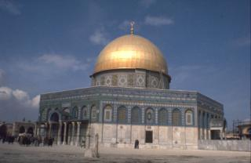
SPIRITUALITY OF THE EUCHARISTIC LITURGY
感恩祭禮儀靈修
Just look at some verses of Ps. 122:
I was glad when they said to me; “Let us go to the house of the Lord!”
Our feet have been standing, Within your gates, O Jerusalem!
Jerusalem, built as a city, which is bound firmly together
To which the tribes go up, the tribes of the Lord
As was decreed for Israel, to give thanks to the name of the Lord
There thrones for judgment were set, the thrones of the house of David
Cf. Exodus 34,23; 13, 1-2; Dt 12, 1-14
請細讀詠122：
我喜歡，因為有人向我說：我們要進入上主的聖殿！
耶路撒冷！我們的雙足，已經站立在你的門口。
耶路撒冷建築的好似京城，確是內部劃一整齊的京城。
各支派，上主的各支派都齊集在那裡，按照以色列的法律稱頌上主的名字。
那裡設立了執政的座席，那裡有達味王室的寶位。
參照：出34:23; 13:1-2; 申12:1-14

Slide 18

SPIRITUALITY OF THE EUCHARISTIC LITURGY
感恩祭禮儀靈修
Let us look at some verses from Ps 42 as well:
As a deer longs for flowing streams, so longs my soul for you, o God
My soul thirsts for God, for the living God
When shall I come and behold the face of God?
My tears have become my food day and night,
While men say to me continually, “Where is your God?”
These things I remember, as I pour out my soul;
How I went with the throng, and led them in procession to the house of God
With glad shouts and songs of thanksgiving, a multitude keeping festival
請也細讀詠42：
天主，我的靈魂渴慕你，真好像牝鹿渴慕溪水。 我的靈魂渴念天主，生活的天主，
我何時來，能把天主的儀容目睹？
有人終日向我說：「你的天主在那裡？」
我的眼淚竟變成了我晝夜的飲食。
我想起昔日周旋在歡樂的群眾裡，在群眾歡呼讚頌的歌聲裡，領他們朝覲天主的聖殿時，我的心不免感到憂傷哀悲，我的靈魂，你為何悲傷，為何憂苦？期望天主！
因為我還要向他頌祝，因為他
是我的救援，是我的天主。

Slide 19
SPIRITUALITY OF THE EUCHARISTIC LITURGY
感恩祭禮儀靈修
Did Jesus join any pilgrimage ?
耶穌曾經朝聖嗎？

Slide 20
SPIRITUALITY OF THE EUCHARISTIC LITURGY
Read:
Luke 2, 41-42
請讀路2:41-42：
他【耶穌】的父母每年逾越節必往耶路撒冷去。他到了十二歲時，他們又照節日的慣例上去了。

Slide 21
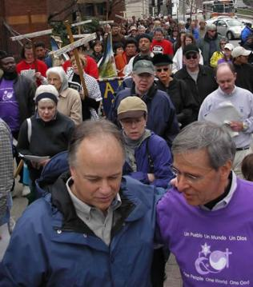
SPIRITUALITY OF THE EUCHARISTIC LITURGY
感恩祭禮儀靈修
There are some very inspiring insights about pilgrims and pilgrimages.
關於朝聖者及朝聖的反省：
朝聖者都有靈性的目的地
真實的朝聖者有賴天主的帶領和其他人的愛和支持
Pilgrims have a spiritual destination
Pilgrims (real ones!) depend on God’s providence and the love and support of one another
Pilgrims know that they are impermanent, and consequently live a simple life here on earth.
Due to their dependence on one another they tend to live a better community life
They are naturally very prayerful people
The entrance procession is inspired by this concept of a pilgrim people, and the sanctuary represents the spiritual destination, the heavenly Jerusalem.
3. 朝聖者認識到世旅短暫，只需簡單生活
4. 明白到需要互相依賴，因而改善團體生活
5. 朝聖者常是喜歡祈禱的人
進堂遊行受朝聖子民的概念所啟發；聖所代表靈性的目的地：天上的耶路撒冷

Slide 22
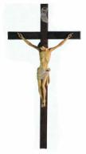

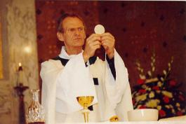
SPIRITUALITY OF THE EUCHARISTIC LITURGY
感恩祭禮儀靈修
The formation of an Entrance Procession
進堂遊行的形成：環繞三個中心點
An entrance procession forms itself round three centres.
The Calvary Crucifix
十字苦像（遊行十字架）
The Book of Gospels 福音書
The Presiding Celebrant
主禮

Slide 23
SPIRITUALITY OF THE EUCHARISTIC LITURGY
感恩祭禮儀靈修
The formation of an Entrance Procession
進堂遊行的形成：環繞三個中心點
十字架苦像不單為感恩祭慶典定調，也為整個基督徒生命定調。十字架是完整逾越奧蹟的標記，結合著苦難及復活。我們顯示十字架，告訴世界：只有經歷苦架之路，我們才能得到永生。
持十字架時，必須陪同相稱的敬禮標記。傳統的敬禮標記，有香、蠟燭。故此，進堂遊行時，乳香常領頭，即燃點著、香烟瀰漫的吊爐
An entrance procession forms itself round three centres.
The Calvary Crucifix sets the tone not only for the Celebration of the Eucharist, but also for the whole of Christian life.
It is a symbol of the full Paschal Mystery which incorporates the passion and the resurrection as well.
We show the Cross to tell the world that it is only through the Way of the Cross that we would be able to have life eternal.
When the Cross is carried it is imperative that we carry signs of reverence proper to it. The traditional signs of reverence are incense and light. That is why the thurifer always leads the entrance procession(of course with a lighted censer that emanates fragrant smoke profusely!)

Slide 24
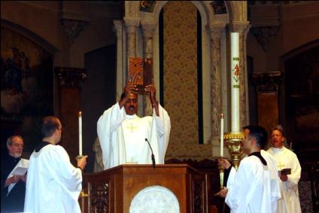
SPIRITUALITY OF THE EUCHARISTIC LITURGY
感恩祭禮儀靈修
The Book of Gospels represent the Liturgy of the Word of the Mass, and is immediately followed by the co-celebrants or the presiding celebrant of the Mass. This is to show the intrinsic connection between the Liturgy of the Word and the Liturgy of the Eucharist.
福音書代表彌撒中的聖道禮儀，尾隨著共祭及主禮。這顯示出聖道禮儀與聖祭禮儀的內在連繫。
All other ministers(acolytes, lectors, cantors, extraordinary ministers of Holy Communion, ushers, flag bearers representing sodalities, confraternities or parish BECs etc. take their place between the Crucifix and the Book of Gospels).
其他輔禮人員（輔祭員、讀經員、領唱員、非常務送聖體員、接待員、持旌旗手代表團體、組別或堂區團體等等，在十字架與福音書之間就位）

Slide 25
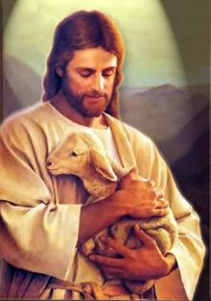
CHRIST IS THE CENTRE OF THE ENTRANCE PROCESSION
基督是進堂遊行的中心
CALVARY CRUCIFIX - JESUS cHRIST
十字架 耶穌基督
BOOK OF GOSPELS - JESUS cHRIST
福音書 耶穌基督
PRESIDING CELEBRANT - JESUS cHRIST
主禮 耶穌基督

Slide 26
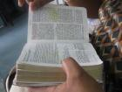
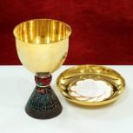
THE ENTRANCE PROCESSION REPRESENTS THE TWO MAIN PARTS OF THE MASS
進堂遊行代表彌撒的兩個主要部分
CALVARY CRUCIFIX - JESUS cHRIST
十字架 耶穌基督
BOOK OF GOSPELS - LITURGY OF THE WORD
福音書 聖道禮儀
PRESIDING CELEBRANT - LITURGY OF THE EUCHARIST
主禮 聖祭禮儀

Slide 27
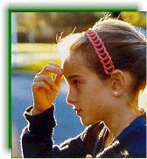
Sign of the Cross 十字聖號
What does the Sign of the Cross mean?
Does it have any Biblical foundation?
How do we teach our children the meaning of the Sign of the Cross?
十字聖號有什麼意義？
它有什麼聖經基礎？
我們怎樣教導孩子十字聖號的意義？

Slide 28
SPIRITUALITY OF THE EUCHARISTIC LITURGY
感恩祭禮儀靈修
SIGN OF THE CROSS (GIRM彌撒經書總論Nos. 31, 50, 124)
十字聖號
Historical information
The sign of the Cross certainly is an ancient Christian symbol and gesture. But it was only by the fourth century that it became a ritual gesture and a symbol during the celebration of the sacraments. In fact, it is attested in the Roman liturgy as late as the
medieval introduction
of the prayers at the foot
of the altar. At that stage
the Amen was said not by
the congregation, but by
the priest himself.
(Lawrence Johnson, op.cit. )
歷史資料
十字聖號固然是古老的基督徒標記和姿勢。但它只在四世紀才成為舉行聖事時的一個禮儀行動。事實上，羅馬禮在中世紀才引入它為台下念的禱文。 當時， 「亞孟」並非由團體答的，而是由司祭本人念的。(參Lawrence Johnson)

Slide 29
SPIRITUALITY OF THE EUCHARISTIC LITURGY
感恩祭禮儀靈修
SIGN OF THE CROSS (GIRM彌撒經書總論Nos. 31, 50, 124) 十字聖號
Theology of the Sign of the Cross
The sign of the Cross is the most important and popular Christian symbol because It represents Jesus Christ and His Salvific Paschal Mystery.
The sign of the Cross is actually a mark of ownership, and not a mere gesture. Indeed it is a MARK!
十字聖號的神學
十字聖號是最重要和最普遍的基督徒標記，因為它代表耶穌基督和他充滿救恩的逾越奧蹟。
十字聖號不只是一個姿勢，其實是一個被擁有的記號，確是一個印記！

Slide 30
SPIRITUALITY OF THE EUCHARISTIC LITURGY
感恩祭禮儀靈修
SIGN OF THE CROSS (GIRM彌撒經書總論Nos. 31, 50, 124) 十字聖號
Read: Exodus 12, 13
The blood of the lamb was God’s mark of ownership
The scarlet ribbon was a mark that saved Rahab, the harlot of Jericho who hid the two spies sent by Joshua(Joshua 2,18).
* Read Genesis 4,9
God knows what happened to Abel. He questions Cain about his brother.
◎讀：出12:13
這血在你的所住的房屋上，當作你們的記號。
羔羊的血是「屬於上主」的記號
◎耶里哥妓女辣哈布，隱藏了若蘇厄派來的兩個偵探；後來，她也靠朱紅綫為記號，而被救。
就是當我們再到這地方時，你應將這根朱紅綫繫在你縋下我們的窗戶上，並且叫你的父母、兄弟和你父親全家人口，都聚集在你這屋內。(蘇2:18)
◎讀創4:9
上主對加音說： 「你弟弟亞伯爾在那裡？」他答說： 「我不知道，難道我是看守我弟弟的人？」
天主知道亞伯爾發生了什麼事。他向加音質問弟弟的蹤跡。

Slide 31
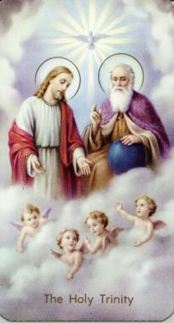
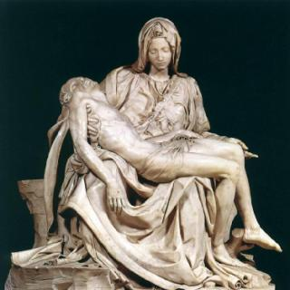
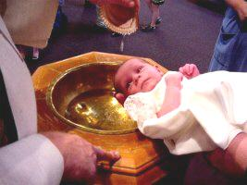
SPIRITUALITY OF THE EUCHARISTIC LITURGY
感恩祭禮儀靈修
Making the sign of the Cross ritually has three meanings:
  It reminds one of the salvation brought to us by Jesus Christ through His Paschal Mystery(Acts 4,12)
  It makes the Mystery of the Holy Trinity present to us
  It reminds us about our baptism(Romans 6,3-4)
劃十字聖號儀式上三項意義：
它提醒耶穌基督藉他的逾越奧蹟帶給我們的救恩(宗4:12)
它使聖三奧蹟呈現在我們面前
他提示我們記得自己的洗禮(羅6:3-4)

Slide 32
Greeting 致候
Why does the chief celebrant greet the people at the beginning of the Mass? Is it a social greeting?
From where do we get this greeting we have in the Mass?
Why use such a formal and a seemingly artificial greeting?
Why does the priest extend his hands during the greeting?
為什麼主禮在彌撒開始時向人致候？這是否社交上的「打招呼」？
彌撒中的致候詞來自哪裡？
為什麼要用這麼公式化，且看來不自然的致候詞？
為什麼主禮致候時伸開雙手？

Slide 33

SPIRITUALITY OF THE EUCHARISTIC LITURGY
感恩祭禮儀靈修
GREETING
致候
歷史資料
彌撒開始時致候的做法，肯定比彌撒中劃十字聖號更為古老
Historical Information
This feature at the beginning of the Mass is certainly older than the Sign of the Cross within the Mass
四世紀以後，初時羅馬禮以致候作為集禱經的序言。羅馬及埃及所用的傳統格式：「願主與你們同在」，答句：「也與你的心靈同在。」其實，這是提醒司祭在領受聖秩時已領受天主聖神，所以他是「基督的服務員」(格前4:1)
In the Roman Rite of the
early times after the fourth
century, it served as an
introduction to the Opening Prayer of the Mass. The traditional formula used in Rome and in Egypt was: The Lord be with you. And the response was: And also with your Spirit. In fact, this was a reminder to the priest that he has received the Holy Spirit of God at Ordination, and is thereby a ‘Special Minister of Christ’(1 Corinthians 4,1).

Slide 34
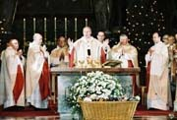
SPIRITUALITY OF THE EUCHARISTIC LITURGY
感恩祭禮儀靈修
We need to understand that this Greeting is a special one based on Holy Scripture; and not one that is casual and informal.
“The greeting does not exclude a hearty personal tone… However, this greeting should not be spoken in a casual manner or may be even embellished with joking comments. There are more than a few participants in every service of worship who are full of sorrow, suffering and grief, and have come seeking comfort and power to bear their heavy fate.
For this reason a definite reserve and objectivity are recommended. The official greeting texts of the Missal
provide this reserve and
Objectivity without requiring the
elimination of a tone of
heartfelt greeting”.
(Adolf Adam, The Eucharistic
Celebration, The Liturgical
Press, Collegeville, 1994)
這致候詞是特定的，有其聖經基礎，不宜隨意或輕佻。
致候並不排除衷心親切的語氣……但這致候詞不應隨便或為了惹笑而加以潤色。每次崇拜，總有或多或少參禮者懷著憂傷而來，尋求安慰和力量。為此，適宜收歛和持平。彌撒經書提供的致候詞正是既收歛持平，又不失親切。(Adolf Adam, The Eucharistic Celebration, The Liturgical Press, Collegeville, 1994)

Slide 35
SPIRITUALITY OF THE EUCHARISTIC LITURGY
感恩祭禮儀靈修
GREETING
致候
The grace of our Lord Jesus Christ, and the love of God, and the communion of the Holy Spirit
Be with you all.
or
Grace to you and peace
from God our Father and
the Lord Jesus Christ.
or
The Lord be with you.
R. And with your spirit.
願主耶穌基督的恩寵，和天父的愛情，以及聖神的相通，與你們同在。(格後13:13)
或
願天父和基督的恩寵及平安與你們同在。
或
願主與你們同在。
答：也與你的心靈同在。

Slide 36
SPIRITUALITY OF THE EUCHARISTIC LITURGY
感恩祭禮儀靈修
This is a formal greeting which expresses that the gathered community is not some individuals that have come together to form a crowd of people, or individuals called at random to attend a ceremony. It means that this is a very special gathering of a community of God’s people, specially called and chosen by baptism and by the Word of God. It is the right and privilege of this people to celebrate the Eucharist. Hence, a special kind of greeting is used that is exclusive to the identity of this people.
Read: 1 Peter2,9-10
And compare with
Exodus19, 6 and
Revelation5,9-10
這是有規格的致候，表達出這相聚的團體，不是隨便一群人，或是隨機聚來只為出席一個慶典的群眾。
這是非常特別的天主子民的團體聚會：透過聖洗及天主聖言，這會眾被特別召集和揀選，才有權利和資格，慶祝感恩祭。因此，這特別的致候，把這會眾識別出來。
你們卻是特選的種族，王家的司祭，聖潔的國民，屬於主的民族……你們從前不是天主的人民，如今卻是天主的人民；從前沒有蒙受愛憐，如今卻蒙受了愛憐。(伯前2:9-10)
你們為我應成為司祭的國家，聖潔的國民。(出19:6)
【那四個活物和那二十四位長老伏在羔羊前，】唱新歌說：「惟有你當得起接受那書卷和開啟它的印，因為你曾被宰殺，曾用你的血，從各支派、各異語、各民族、各邦國中，把人贖來歸於天主，並使他們成為國度和司祭，事奉我們的天主；他們必要為王，統治世界。」(默5:9-10)

Slide 37
Penitential Rituals 懺悔儀式
How many options are available in the Missal for the penitential ritual?
Why many options?
Have they any theological foundation?
彌撒經書提供多少懺悔禮的選擇？
為什麼有多個選擇？
它們有沒有神學基礎？

Slide 38
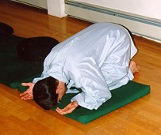
SPIRITUALITY OF THE EUCHARISTIC LITURGY
感恩祭禮儀靈修
(GIRM – 51,45)
PENITENTIAL RITE 懺悔禮
There are, in the present rite of the Mass, three options for the celebration of the penitential rite:
Penitential prayer
(I confess…)
(2)Christological litany
(3)Rite of aspersion
梵二彌撒的懺悔禮有
三個選擇：
一、悔罪經
二、向基督呼救的禱文
上主，求你垂憐。
因爲我們得罪了你。
上主，求你大發慈悲。
賜給我們救恩。
或基督，你奉命來拯救懺悔的人，求你垂憐
上主，求你垂憐。
基督，你來召喚罪人：求你垂憐。
基督，求你垂憐。
上主，你在天父面前，爲我們轉求：求你垂憐。
上主，求你垂憐。
三、灑聖水

Slide 39
SPIRITUALITY OF THE EUCHARISTIC LITURGY
感恩祭禮儀靈修
PENITENTIAL RITE 懺悔禮
(GIRM 羅馬彌撒經書總論– 51,45)
Theological dimension
Each of these rituals has its very special theological emphasis.
(1) Penitential prayer emphasizes the personal acknowledgement of guilt and responsibility for sins and the concept of the Communion of Saints
Christological litanies emphasize the centrality of Jesus’ work of redemption
The rite of aspersion emphasizes a baptismal theology of reconciliation
We need to study each rite separately to unearth the theological and spiritual inspirations hidden within.
神學幅度
這三套儀式各有神學重點。
1.「悔罪經」著重個人認罪，承擔罪責，以及與聖者的共融。
2.「向基督呼救的禱文」強調基督的救贖工程。
3. 強調洗禮的神學：帶來修和。
我們需要研究每一式，找出它們所隱藏的神學及靈修意義。

Slide 40
SPIRITUALITY OF THE EUCHARISTIC LITURGY
感恩祭禮儀靈修
We need to analyse each line briefly:
I confess - Personal acknowledgement of one’s sinfulness.
To almighty God and to you my brothers and sisters – Sins are confessed to God and to one another. This brings out both the vertical and the horizontal dimension of the repercussions of sin.
That I have sinned through my own fault – Personal acknowledgement of the total responsibility for one’s sins without palming the blame over to any others.
In my thoughts, in my words, in what I have done, and in what I have failed to do – Ways of committing sins are stated. Sins of commission as well as those of omission are mentioned. Adolf Adam(op.cit.) says, “The new Confiteor helps us to see that we are guilty by failing to do what is good; For failing to be the salt of the earth, light of the world.”
試簡單逐句分析：
我…承認
－個人為自己的罪認錯
向全能的天主和各位兄弟姐妹
－向天主認罪，也彼此認罪。這帶出罪帶來的禍害，是縱向，也是橫向的。
我罪、我罪、我的重罪
－不委過於他人，個人負起犯罪的全責
在思、言、行爲上的過失
－講出犯罪的方式：所犯的「過」，以及「應做未做」的「失」：未做好地鹽世光所應做的(參Adolf Adam)

Slide 41
SPIRITUALITY OF THE EUCHARISTIC LITURGY
感恩祭禮儀靈修
And I ask Blessed Mary, ever-virgin, all the angels and the saints – Invitation of the Communion of Saints to intercede for us
And you my brothers and sisters, to pray for me, to the Lord our God – Once again those present are very specially invited to pray for one another.
This prayer contains, therefore, a number of important theological concepts, and the community consciousness is quite prominent.
為此，懇請終身童貞聖母瑪利亞、天使、聖人，
邀請聖人為我們轉求。
和你們各位兄弟姐妹，爲我祈求上主、我們的天主。
再次，特別邀請所有在場的人彼此代禱。
所以，這禱文包含眾多重要的神學意思，而且團體意識相當明顯。

Slide 42
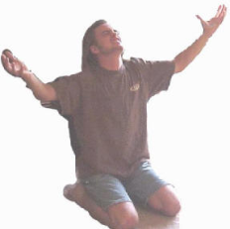
SPIRITUALITY OF THE EUCHARISTIC LITURGY
感恩祭禮儀靈修
2. 向基督呼救的禱文
上主，求你垂憐。
基督，求你垂憐。
上主，求你垂憐。
或 上主，求你垂憐。
因爲我們得罪了你。
上主，求你大發慈悲。
賜給我們救恩。
或 基督，你奉命來拯救懺悔的人，求你垂憐。
上主，求你垂憐。
基督，你來召喚罪人：求你垂憐。
基督，求你垂憐。
上主，你在天父面前，爲我們轉求：求你垂憐。
上主，求你垂憐。
(2) Christological Litanies
These could be simply the ‘Lord, have mercy’ ‘Christ, have mercy’ lines or the longer versions such as ‘You were sent to heal the contrite, Lord, have mercy’ ‘You came to call sinners, Christ have mercy’ ‘You plead for us at the right hand of the Father, Lord, have mercy’
Whether in the shorter version or the longer one the emphasis is crystal clear. They derive inspiration from the scriptures and are eloquent about the reconciling power of the Paschal Mystery of Jesus Christ. They are totally Christo-centric.
無論長式短式，重點都清晰：以基督為中心；由聖經取材，表達耶穌基督逾越奧蹟的修和力量。

Slide 43
SPIRITUALITY OF THE EUCHARISTIC LITURGY
感恩祭禮儀靈修
(2) Christological Litanies
Already in the Gospels we find incidents which at a later period were sources of inspiration to Christological Litanies such as these. Let us look at some such examples:
(1) Jesus, Son of David, have mercy on me/us
(2) Lord, if you wish you can heal me
(3) Lord, have mercy on my Son
(4) Jesus, remember me when you are in paradise
(5) My Lord, My God
2. 向基督呼救的禱文
福音中眾多事件後來都成為向基督呼救禱文的來源，例如：
耶穌，達味之子，可憐我(們) 。
主，你若願意，就能醫治我。
主，可憐我的兒子。
耶穌，在你的國內，求你紀念我。
我主，我天主。

Slide 44
SPIRITUALITY OF THE EUCHARISTIC LITURGY
感恩祭禮儀靈修
(3) The rite of aspersion (Asperges Me, Domine…)
In the present rite of aspersion, as pointed out by Joseph Champlin(The Mystery and the Meaning of the Mass, Claretian Publications, Quezon City, 2001) we express gratitude for the gift of water, seek liberation from sin and recall baptismal grace. It is like the great prayers of Birkat-ha-mazon of the Jews during which they gave thanks for the gift of land, for food and for Jerusalem.
3. 灑聖水禮
目前的灑聖水禮，表達感謝水的恩賜，祈求罪過的赦免，重溫聖洗恩寵。它類似猶太人在安息日用餐的感恩禱文：感謝大地、糧食，以及耶路撒冷。
If celebrated well, the priest has to bless water after the greeting. There are three different prayers for the blessing of water in the Missal. Then sprinkle the faithful while a baptismal hymn or a penitential hymn is sung.
理想的話，司祭在致候之後，先祝聖水。彌撒經書提供三式祝福聖水禱文。然後灑在信友身上，並唱關於聖洗或悔罪的歌。

Slide 45
SPIRITUALITY OF THE EUCHARISTIC LITURGY
感恩祭禮儀靈修
(3) The rite of aspersion (Asperges Me, Domine…)
This originated in the 8th century as a sign of sanctification. But it clearly assumed a baptismal character with time. Hence, this rite is especially suitable during the Easter season. That is why even today sprinkling does not denote entirely a penitential character(GIRM 51)
This was what took place before the main Masses on Sundays according to the 1570 Missal. It is based on Psalm 51,9 (Cleanse me of sin with hyssop that I may be purified). During the Paschal time it was replaced with Vidi Aquam… based on Ezekiel 47,1.8-9(I saw water flowing our from beneath the threshold of the temple…).
3. 灑聖水禮
這儀式源於八世紀，作為淨化的標記。但它漸與聖洗連結。故此，這儀式在復活期尤其合適。今日，它已不只表達懺悔之意。(羅馬彌撒經書總論51)
按1570年彌撒經書，每主日都行灑聖水禮。
它的聖經基礎是詠51:9
求你以牛膝草灑我，使我皎潔，求你洗滌我，使我比雪還要白。
復活期則念則47:1,8-9
看，有水從聖殿流出……
.

Slide 46
SPIRITUALITY OF THE EUCHARISTIC LITURGY
感恩祭禮儀靈修
Alonso Schökel ‘s analysis:
(1) The Summons
This is implicit at Mass.
Old Testament texts:
Ps. 50,6.7.21;
Jeremiah 2, 5.8.13
Psalm 50,21: These things you have done. Am I to stay silent?
Alonso Schökel的分析：
傳召上庭
這是彌撒所暗示的。
舊約詠50:6,7,21
諸天要宣示天主的公正，因為他要親自審判世人。 「請聽，我的子民，我要發出言語，以色列，我向你警戒告訴，我是天主，我是你的天主。……你既作了這些，我豈能緘口不言？
耶2:5,8,13
上主這樣說：你們的祖先在我身上發見了甚麼不義，竟遠離我而去追隨「虛無」，自成為虛無呢？……
司祭們也不問一問：「上主在那裡？」那些管理法律的，不認識我了；那些為人牧的，叛離了我；先知們也奉巴耳講預言，追隨無能的神祇。……
因為我的人民犯了雙重的罪惡：他們離棄了我這活水的泉源，卻給自己掘了蓄水池，不能蓄水的漏水池。
詠50:21你既作了這些，我豈能緘口不言？

Slide 47
SPIRITUALITY OF THE EUCHARISTIC LITURGY
感恩祭禮儀靈修
Alonso Schökel ‘s analysis:
The Summons
The accusation is based upon obligations which had been agreed upon, and it appeals to them.
Psalm 50,5: Gather to me my faithful who made a covenant with me by sacrifice.
Psalm 50,16: What right have you to recite my statutes or take my covenant on your lips?
Schökel shows that the protocol for the new covenant of Jesus Christ is not the Decalogue anymore, but the Gospel. The Gospel summons us, accuses us, offers us pardon and reconciles us. That is why we say: Per Evangelica dicta deleantur nostra delicta
Alonso Schökel的分析：
傳召上庭
雙方既有協定，不履行責任的，要面臨控訴。
詠50:5 你們應當給我聚集起虔敬我的人，就是那以犧牲與我訂立盟約的人。
詠50:16 你怎麼膽敢傳述我的誡命，你的口怎敢朗誦我的法令？
Schökel指出：耶穌基督所訂的新約的準繩，已不再是十誡，而是福音。福音教訓我們，控訴我們，寬恕我們，與我們修和。故此，我們說：

Slide 48
SPIRITUALITY OF THE EUCHARISTIC LITURGY
感恩祭禮儀靈修
The accused may defend himself denying the facts or charges. But when it is God who reproves our conduct how can we deny? So, we become speechless. That is the space of silence during the ritual. The guilty party recognizes that there is no possibility of defense.
Psalm 32, 5: I said I will confess my sins to the Lord
Psalm 51,1-3: Wash me thoroughly from my sins; for I know them
被告一方固然可以否認控罪。但在天主面前，誰能自認無罪？所以，我們無言以對。這就是懺悔禮中的靜默：罪人承認已不可抵賴。
詠32:5我終於向你承認我的罪過，絲毫也沒有隱瞞我的邪惡，我說：「我要向上主承認我的罪孽，」你即刻便寬赦了我的罪債。
詠51:1-3天主，求你按照你的仁慈憐憫我，依你豐厚的慈愛，消滅我的罪惡。求你把我的過犯洗盡，求你把我的罪惡除淨，因為我認清了我的過犯，我的罪惡常在我的眼前。

Slide 49
SPIRITUALITY OF THE EUCHARISTIC LITURGY
感恩祭禮儀靈修
The accused may defend himself denying the facts or charges. But when it is God who reproves our conduct how can we deny? So, we become speechless. That is the space of silence during the ritual. The guilty party recognizes that there is no possibility of defense.
Also we could refer: Psalm 38,5; 65,3; 130, 3-4; Jeremiah 3, 22.25
被告一方固然可以否認控罪。但在天主面前，誰能自認無罪？所以，我們無言以對。這就是懺悔禮中的靜默：罪人承認已不可抵賴。
詠38:5因為我的罪過高出我的頭頂，好似重擔把我壓得過分沉重。
詠65:3我們的罪重壓著我們，但你都一一赦免不存。
詠130:3-4上主，你若細察我的罪辜，我主，有誰還能站立得住？可是，你以寬恕為懷，令人對你起敬起愛。
耶3:22,25「歸來！失節的子民，讓我療愈你們的失節。」「看，我們回到你這裡，的確，你是上主，我們的天主。……讓我們躺臥在我們恥辱中，讓我們以羞愧遮蓋我們，因為我們和我們的祖先，自我們幼年直到今日，得罪了上主我們的天主，從來沒有聽從上主我們的天主的聲音。」

Slide 50
SPIRITUALITY OF THE EUCHARISTIC LITURGY
感恩祭禮儀靈修
In the manner described by Schökel reconciliation can take place in three different ways.
Offender-debtor makes restitution or totally satisfies the offended person
There is some form of agreement or settlement. The offended person accepts partial compensation, a modest reparation and states himself satisfied.
The offended party renounces his rights and pardons completely the debts and all the offences.
The Mass belongs to the third form. God does the pardoning and seals the reconciliation with a Banquet!
按Schökel的意見，修和可以三種方式達成：
犯人（或欠債者）全數賠補，直至被干犯的一方滿意為止。(以牙還牙，以眼還眼)
達成某些協議。被干犯的一方接納部分賠償，稍作彌補，然後宣布他本人已經滿意。
被干犯的一方主動放棄權益，全數寬免欠債，不再追究。
彌撒採用的，是第三種方式。天主寬免一切罪債，更設宴作為修和的印記！

Slide 51
LITURGY OF THE WORD
STRUCTURE OF THE LITURGY OF THE WORD
聖道禮儀的結構
Why do we have a fixed structure for the liturgy of the Word?
(First Reading,
Responsorial Psalm,
Second Reading,
Gospel Acclamation,
Gospel Proclamation,
Homily,
Creed,
Prayer of the Faithful)
Why cant we change the readings according to our whim and fancy?
為什麼聖道禮儀有固定結構？
(讀經一
答唱詠
讀經二
福音前歡呼
宣讀福音
講道
信經
信友禱文
為什麼不能按喜好更改讀經？

Slide 52
STRUCTURE OF THE
LITURGY OF THE WORD
聖道禮儀的結構
SYNAGOGUE 會堂 | PRESENT CATHOLIC MASS 今日天主教彌撒
Reading from the Law of Moses選讀梅瑟法律 | First Reading讀經一
Responsorial Psalm答唱詠 | Responsorial Psalm答唱詠
 | Second Reading讀經二
 | Gospel Acclamation福音前歡呼
Reading from the Prophets選讀先知 | Gospel Proclamation宣讀福音
Homily講道 | Homily講道
 | Creed信經
Prayer of the Faithful信友禱文 | Prayer of the Faithful信友禱文

Slide 53
STRUCTURE OF THE
LITURGY OF THE WORD
聖道禮儀的結構
Why should we follow the Lectionary as it is ?
為什麼我們要跟隨讀經集的安排：
1963年禮儀憲章頒布後，成立了專責修訂《讀經集》的特別委員會，包括禮儀、聖經、牧民神學專家；它的成員更由一個小組，擴展至來自世界各地的100位以上。
After the promulgation of Sacrosanctum Concilium in 1963,
a special Commission was set up to revise the lectionary.
The Commission comprised experts from the field of liturgy, scripture, pastoral theology etc.
Though initially small, it was later expanded to comprise over 100 members from different parts of the globe.

Slide 54
STRUCTURE OF THE
LITURGY OF THE WORD
聖道禮儀的結構
They began by studying the Jewish synagogue liturgy and the lectionaries which were used in the Catholic Mass down the centuries.
Some very important principles were worked out to design the new lectionary.
By 1967 the first draft was ready for inspection and observations.
The the final draft was presented by December 1969.
修訂《讀經集》特別委員會，研究猶太會堂禮儀，以及歷代天主教彌撒所曾採用的讀經集。
訂定設計新讀經集的重要原則
1967年完成第一草擬，以供檢查和視察
1969年12月，呈交最後草擬。

Slide 55
STRUCTURE OF THE
LITURGY OF THE WORD
聖道禮儀的結構
A few such principles are mentioned below:
A three-year cycle was designed, based on the Synoptic Gospels, for the Sundays of the Ordinary Time of the Liturgical Year.
The Paschal Mystery is the centre of the LY.
Sunday was considered the centre around which other days develop thematically.
On Sundays the first reading was thematically aligned with the Gospel text. The second reading follows an independent semi-continuous pattern.
A two-year cycle was designed for the first reading of the weekdays in the O. T.
其中一些原則：
禮儀年中的常年期主日，按對觀福音，設計成三年循環。
逾越奧蹟是禮儀年的中心。
以主日為中心，其他日子環繞它的主題發展。
主日的讀經一要配合福音的主題。讀經二則採用獨立若連續的編排。
平日讀經採用兩年為一循環。

Slide 56
JEWISH CONNECTION OF THE LITURGY OF THE WORD
聖道禮儀與猶太禮儀的關係
我們的聖道禮儀與猶太人逾越節晚餐禮儀關係密切。
猶太人逾越節晚餐有兩個敍述模式：
年次
周次
我們也一樣。
Our Liturgy of the Word is closely connected to the Passover Haggadah of the Jewish Passover.
They have two modes of narrating the Haggadah.
1. Annual
2. Weekly
We have the same pattern.

Slide 57
GOSPEL PROCLAMATION
宣讀福音
宣讀福音是彌撒第一部分的高峰。
儀式上，我們怎樣認知這事？
The Gospel proclamation is the highest point in the first part of the Mass.
How do we ritually realise this?

Slide 58
Gospel Proclamation
宣讀福音
聽福音的人，並不止在歷史中與耶穌相遇，或如新約的書信，認出他及反省他的意義。事實上，聽福音者正陪伴世上的耶穌走生命之路。面對耶穌提出的要求，他們必須決定：接受或拒絕耶穌
執事是福音的常務服務員，因為他是僕人基督的特別象徵。
The person who listens to the Gospel does not merely encounter Jesus in a historical account or, as in the case in the New Testament epistles, in a confession to Him or a reflection of His significance. Rather the hearers of the Gospel experience themselves as accompanying the earthly Jesus along the path of life. They find that they are required to make decisions for or against the claims and demands that Jesus makes…(Gerhard Ludwig Müller, Lasst uns mit Ihm gehen: Eucharistiefiern als Weggemeinschaft, Freiburg: Herder, 1990, p.65)
Deacon is the ordinary minister of the Gospel. He was considered to be the special exemplar of Christ the Servant.

Slide 59
There are always special signs of reverence at the proclamation of the Gospel:
宣讀福音常有致敬的標記：
    (i)
    (ii)
    (iii)
    (iv)
    (v)
    (vi)
    (vii)
    (viii)
    (ix)
    (x)
    Blessing obtained before the proclamation
    宣讀前請求祝福
    Standing posture全體站立
    Incense奉香
    Light蠟燭
    Signs of the Crosses劃十字聖號
    Kissing of the Book of Gospels親福音書
    Acclamations歡呼
    Procession with the Book of Gospel遊行
    Ornamentation of the Book of Gospel裝飾福音書
    A special minister of the Gospel特別的福音服務員

Slide 60
Standing for the Gospel is a sign of welcome, respect, alertness, jubilation, awe inspiration and respect.
Some of the signs mentioned above such as the signs of the Crosses, kissing of the Book of Gospels, were introduced around the 8th century.
Acclamations addressed to Christ are from the Carolingian times.
By the 11th century the Book of Gospels began to be incensed.
Around the year 1000, May the words of the Holy Gospel wipe away our sins … was introduced.
起立迎接福音，表示歡迎、尊敬、醒悟、歡欣發啟 、肅然起敬
劃十字聖號、親福音書等儀式，始於8世紀。
向基督歡呼始於查理孟大帝時代。
11世紀開始向福音書奉香。
約在1000年，引入「願所讀的福音，使我們改過遷善」的說話。

Slide 61
We will take a few ritual moments for our reflection…
讓我們反省其中一些儀式的時刻：
預備祭台：
預備禮品
聖祭禮：
感恩經
擘餅
From Preparation of the Altar:
Preparation of the gifts
From the Liturgy of the Eucharist:
The Eucharistic Prayer
Breaking of the Bread

Slide 62
Preparation of the gifts 預備禮品
Why are they called GIFTS?
How did the offertory procession begin in the history?
What are the objectives of bringing offerings?
Are there theological insights which govern the offerings and the preparation of the gifts?
為什麼稱它們為「禮品」？
歷史上，獻禮遊行是怎樣開始的呢？
呈上獻禮的目的是甚麽？
獻禮和預備禮品有沒有神學意義？

Slide 63
Preparation of the gifts 預備禮品
Why are they called GIFTS?
Because we benefit without any cost. FREE. They are totally a result of God’s magnanimity and overflowing generosity.
And they are RECONCILING gifts. They offer reconciliation and invite us to covenant communion.
READ: Isaiah 55, 1-4
為什麼稱它們為「禮品」？
因為我們在没有一點 付出下，由天主的大能和無限仁慈中白白地領受。它全然是天主的恩賜。
它們又是修和的禮物，為修好而呈奉，同時邀請我們締結「共融的盟約」。
讀依55:1-4

Slide 64
Preparation of the gifts 預備禮品
Isaiah 55, 1-4
Invite us to reflect on the FREE and RECONCILING aspects of the gifts.
Gifts mentioned here are Wine and Milk.
READ 55, 6-7
The Lord’s ways are not like our ways. He thinks otherwise. (V.8)
讀依55:1-4 ^{１}啊! 凡口渴的，請到水泉來! 那沒有錢的，也請來罷! 請來買不花錢，不索值的酒和奶吃！^{２}你們為什麼為那些不能充食的東西花錢，為那些不足果腹的東西浪費薪金呢﹖你們若細心聽我，你們就能吃豐美的食物，你們的心靈必因脂膏而喜悅。^{３}你們如側耳，走近我前來聽，你們必將獲得生命；我要與你們訂立一項永久的盟約，即誓許於達味的慈惠。^{４}看，我立了你為萬民的證人，為列國的領袖與主宰。
謞我們反省禮品的其中兩個幅度：無償的，修和的
這裡提到的禮品：酒和奶
讀依55:6-7 ⁶趁上主可找到的時候，你們應尋找他；趁他在近處的時候，你們應呼求他。⁷罪人應離開自己的行徑，惡人該拋棄自己的思念，來歸附上主，好讓上主憐憫他；來歸附我們的天主，因為他是富於仁慈的。
……我的思念不是你們的思念，你們的行徑也不是我的行徑：上主的斷語。(依55:8)

Slide 65
Preparation of the gifts 預備禮品
We shall go a step deeper into this Biblical foundation, of FREE and RECONCILING gifts:
READ: Genesis 42, 25-28.
Joseph GIVES and FORGIVES…
You GIVE best when you FORGIVE.
FREE and RECONCILING !!!
我們再進一步看看禮品的無償與修和本質的聖經基礎：
讀創42:25-28 ²⁵若瑟遂吩咐人將他們的布袋裝滿了糧食，將各人的銀錢仍放在各人的布袋內，並且還給了他們途中所需要的食物；人就對他們這樣做了。²⁶他們將購得的糧食馱在驢上，就從那裡起身走了。²⁷到了客棧，他們中一人打開了布袋拿料餵驢，看見自己的銀錢仍在布袋口，²⁸遂對兄弟們說：「我的銀錢退回來了；看，仍在我的袋裡。」他們心驚起來，彼此戰慄地說：「天主對我們所作的，是怎麼一回事。」
若瑟給予了，也寬恕了……
當你寬恕時，你送上了最好的……
無償並修和！！！

Slide 66
Preparation of the gifts 預備禮品
These gifts are also
SPOTLESS and ABUNDANT
Read:
Exodus, 12, 5
Leviticus 5, 15.18; 6,6
Exodus 16, 35
1 Kings 17, 12-16
John 6, 13
這些禮品也須要是無玷的、豐沛的
讀出12:5羔羊應是一歲無殘疾的公羊，要由綿羊或山羊中挑選
肋5:15,18; 6:6「若有人有了過犯，不慎冒犯了上主的聖物，為賠補自己的過失，應從羊群中取一隻無瑕的公綿羊，依照你的估價，按聖所的幣制折合銀子，獻與上主作贖過祭。……他應照你的估價，從羊群中取一隻無瑕的公綿羊，交給司祭作贖過祭。司祭這樣為他不慎而誤犯的過失，替他行贖罪禮，他才可獲得罪赦……祭壇上的火應常燃不熄。
出16:35以色列子民吃瑪納四十年之久，直到進入有人居住的地方為止；他們吃瑪納，直到進入客納罕地的邊界。
列上17:12-16¹²那寡婦說：「我指著永生上主你的天主起誓：我沒有餅，缸裡只有一把麵，罐裡還有一點油。你看，我正要拾兩根木柴，回去為我和我的兒子做點東西，吃了等死。」¹³厄里亞對她說：「你不用害怕，儘管照你所說的去做；只是先為我做一個小餅，給我拿來！然後，再為你和你的兒子做，¹⁴因為上主以色列的天主這樣說：直到上主使雨落在這地上的那一天，缸裡的麵，決不會用完；罐裡的油，也決不會缺少。」¹⁵那個寡婦就照厄里亞的話去做了；她和厄里亞並她的孩子吃了許多日子；缸裡的麵，果然沒有用完，罐裡的油，也沒有減少，正如上主藉厄里亞所說的話。
若6:13他們【門徒】就把人吃後所剩下的五個大麥餅的碎塊，收集起來，裝滿了十二筐。

Slide 67
Preparation of the gifts 預備禮品
Jesus offered the best gift.
His gift was HIMSELF, offered as the Lamb of the new Covenant sacrificial meal.
His self-gift of Himself was FREE and RECONCILING! Each time we offer HIM at Mass we are nourished with the Bread of Eternal Life and our Covenant relationship.
His self-gift of Himself is SPOTLESS and ABUNDANT!
耶穌奉獻了最好的。祂所預備的正是祂自己，作為新約祭宴的羔羊。
祂把自己奉獻亦是無償的及修和的！每次我們在彌撒中獻上耶穌，我們也由永生之糧及盟約中，得到飽飫。
祂作為禮品也是無玷的，豐沛的！

Slide 68
Preparation of the gifts 預備禮品
What are the attributes of the gifts we offer?
FREE ?
RECONCILING?
SPOTLESS?
ABUNDANT?
我們的獻禮有什麼特徵？
無償的？
修和的？
無玷的？
豐沛的？

Slide 69
Preparation of the gifts 預備禮品
For further reading about offerings in the Old Testament:
Deuteronomy 26, 1-11
About offering of the first fruits which are essentially connected to the story of deliverance and giving of the land.
舊約中的其他証據還有…
申26:1-11
¹當你進入上主你的天主賜給你作產業的土地，佔領後住在那裡時，
²應由上主你的天主賜給你的土地上，將一切田產的初熟之物，取出一部分放在筐裏，往上主你的天主選定立自己名號的地方去，
³到當時供職的司祭前，對他說：「我今日向上主我的天主明認，我已來到了上主對我們的祖先誓許賜與我們的地方。」
⁴司祭就由你手中接過筐子，放在上主你的天主的祭壇前；
⁵然後你就在上主你的天主面前聲明說：「我的祖先原是個飄泊的阿蘭人，下到埃及，同少數的家人寄居在那裏，竟成了一強大有力，人口眾多的民族。
⁶埃及虐待我們，壓迫我們，勒令我們做苦工。
⁷我們向上主我們祖先的天主呼號，上主俯聽了我們的哀聲，垂視了我們的苦痛、勞役和所受的壓迫。
⁸上主以強力的手，伸展的臂，巨大的恐嚇，神蹟奇事，領我們出了埃及，⁹來到這地方，將這流奶流蜜的土地賜給了我們。
¹⁰上主，請看! 我現今帶來了你賜給我的田地裏所出產的初熟之物。」遂將這初熟之物放在上主你的天主面前，俯伏朝拜上主你的天主。
¹¹然後你與肋未人，和住在你中間的外方人，歡樂享受上主你的天主賜與你和你家庭的一切福分。
初果的奉獻與以色列的拯救和承受福地有着密不可分的關係。

Slide 70
Preparation of the gifts 預備禮品
申26:12-15
¹²在第三年，即獻什一之年，當你把你一切出產十分之一，完全取出，分給肋未人、外方人、孤兒和寡婦，並使他們在你的城鎮中吃飽之後，¹³你應到上主你的天主面前說：「我由我家中完全交出了這祝聖的一份，分給了肋未人、外方人、孤兒和寡婦，全照你吩咐我的命令；我沒有違犯你的命令，也沒有忽略。¹⁴這些聖物，在我居喪時，我沒有取食；在不潔中，我沒有交出，更沒有獻給死人；我聽從了上主我的天主的話，全照你吩咐我的一切履行了。 ¹⁵願你由你神聖的住所，由天上俯視，祝福你的人民以色列，和你賜給我們的土地，即你向我們祖先所誓許的那流奶流蜜的地方。」
而什一奉獻則建基於愛德及遵守上主的律例。
For further reading about offerings in the Old Testament:
Deuteronomy 26, 12-15
About offering of the one tenth tithe which is essentially connected to charity and keeping of the precepts of the Lord.

Slide 71
Preparation of the gifts 預備禮品
For further reading:
Exodus 25, 1-9 = Exodus 35, 4-9
Offering for the Temple of Holy of Holies
Exodus 30, 11-16 - Temple Tax
Exodus 35, 20-29 – Offerings brought by people and their willingness to be part of the Temple offerings
Exodus 36, 2-6 - Offerings in abundance.
其他參考閱讀:
出 25:1-9 = 出 35:4-9
為聖所的奉獻
出 30: 11-16
聖殿稅
出 35: 20-29
為製造會幕、聖所及其中的一切, 以色列民各按其能作出奉獻
出 36: 2-6
奉獻是超越所需的

Slide 72
Preparation of the gifts 預備禮品
For further reading:
Exodus 25, 1-9 = Exodus 35, 4-9
Offering for the Temple of Holy of Holies
Exodus 30, 11-16 - Temple Tax
Exodus 35, 20-29 – Offerings brought by people and their willingness to be part of the Temple offerings
Exodus 36, 2-6 - Offerings in abundance.

Slide 73
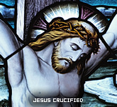
The best and the perfect gift that we offer to the Father is Jesus Christ Himself. We offer our gifts through, with and in Him.
我們向天父所能獻上最完美的祭品就是耶穌基督，並且我們是藉着基督、階同基督、在基督內向天主作出這一奉獻。
REFER: “…we offer you His Body and Blood, the acceptable sacrifice which brings salvation to the whole world. “ EP 4
參：”…我們奉獻祢聖子的體血，願這悅納之祭能為普世帶來救贖。”

Slide 74
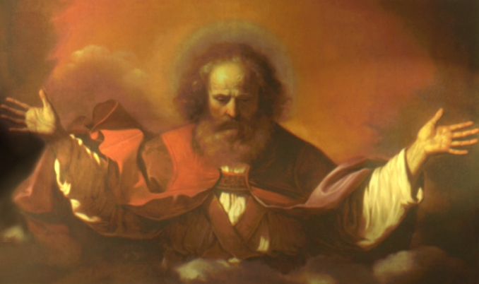
The gifts that we bring to the altar are given to us by God and we have produced a harvest of them through our labour.
我們所呈上這人力的產物作為禮品原是天主的恩賜
REFER: Prayers said by the priest as he prepares the bread and the wine. Blessed are you Lord God almighty, through your goodness we have this bread to offer, which earth has given and human have made, it will become for us the bread of eternal life…”
參：神父在預準餅酒時的禱辭
全能的天主聖父，願我們呈上這大地和人力生產的麵餅將成為我們的生命之糧。

Slide 75

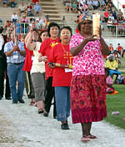
Preparation of the gifts (altar) is a rather sober moment compared to the solemnity with which the Liturgy of the Word and the Liturgy of the Eucharist are celebrated.
相對於成聖體禮的莊嚴和隆重，預備禮品時是較為質樸平靜的。

Slide 76

What takes place at this juncture of the Mass is NOT an offering proper which comes during the Eucharistic Prayer. Here, it is the preparation of the altar.
在這個彌撒中轉折的時候， 我們要關心的並不是在感恩經中各種祭品是否恰當，而是祭台是否已經準備妥當。

Slide 77
The most important gifts are the bread and the wine. Therefore, it is imperative that we bring them at the end of the offertory procession.
祭品的主角是麵餅和酒。所以我們必須把它們留在奉獻禮的最後。

Slide 78
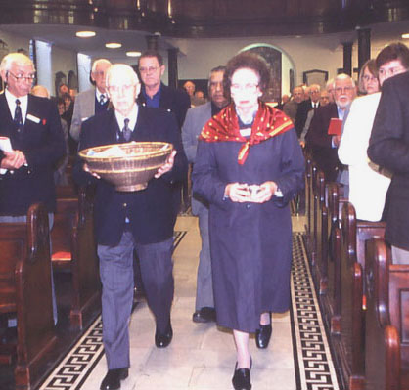
In the early centuries all those who took part in the breaking of the bread ritual brought something to offer.
在早期的教會，每一位參與擘餅禮的人都會準備一些物品作奉獻。

Slide 79
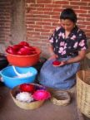
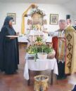
They brought bread and wine made in their homes, gifts for the poor, first fruits of their harvest, oil, wax, milk and honey etc.
他們可能會帶上自製的餅和酒，或是給予窮人的禮物、初果、油、臘、鮮奶、蜜糖等。

Slide 80
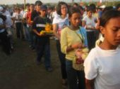
The offerings had a triple purpose:
  to be used during the Mass (bread and wine, oil, wax, etc),
  to be shared with the poor,
  and to support the priests.
這些獻物有三重意義和目的：
  為彌撒提供所需 (如：麵餅和酒、油、臘等)
  與貧窮、有需要的人分享
  支援神職人員。

Slide 81
WHY???
  A Collection of money…
  Mix a drop of water into the chalice…,
  The priest washes his hands….
  Incense the altar, celebrant and the people?
為何這樣做呢???
  奉獻錢…
  將一滴水加到聖爵中…
  神父洗手…
  向祭台、主祭及眾人獻香?

Slide 82
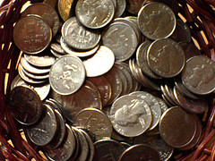
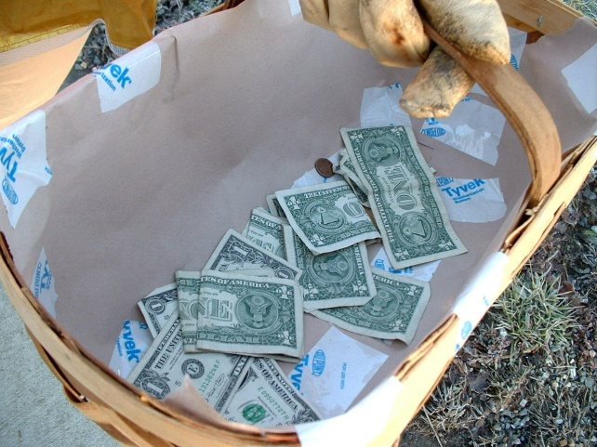
When it became a problem to accept gifts from everyone due to lack of time only a representative group came forward to present gifts to the priest. Others were requested to contribute money. Hence, the collection is part and parcel of the offertory procession. And everyone contributed as a sign of his/her participation in the sacrificial meal.
因奉獻實物耗時過久，後來便演變為只容許一小部份的人作代表把禮品奉獻到祭台前，其他人便以現金代替實物。所以金錢的奉獻只是禮品的一部份。而這些奉獻都成為每一位在埸弟兄姊妹參與感恩祭的標記。

Slide 83
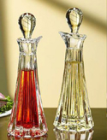
Symbolism of mixing a little water into the wine and washing of hands ought to be clearly understood and properly done. Mixing too much of water into a little of wine may cause problems with regard to the validity of the substance of the wine. Washing of hands need to be an effective gesture of a priest who is spiritually preparing himself to offer the great spiritual sacrifice of all times.
把一點水加入酒中和洗手的標記意義我們需要清楚明白。若把太多的水加入酒中，那就會酒不成酒了。而洗手是標誌着在靈性上神父已準備好隨時作最大的犠牲。

Slide 84
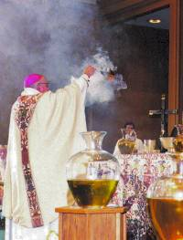
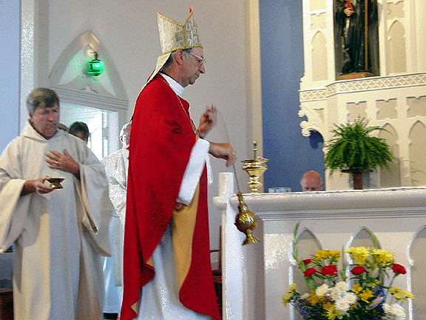
On solemn occasions the altar could be incensed with the gifts. The presiding celebrant and the congregation also could be incensed after the incensation of the altar. We are reminded of our priestly character before we offer the holy sacrifice of Jesus.
在一些重要的時候，我們是會向祭台上的祭品獻香的。有時甚至會向主祭及會眾獻香。這是為了在獻上耶穌的至聖犠牲前提醒我們，我們也負有司祭的職份。

Slide 85
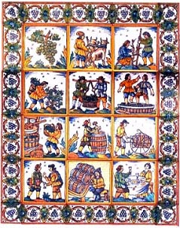

In the middle ages when unleavened bread became the practice in the church, and when the ordinary people distanced themselves from active participation in the Eucharist making bread and wine became the responsibility of monastic communities.
自中世紀開始，當感恩祭規定以無酵餅作祭品時，平信徒便把預備餅酒的責任交給隠修士團體。

Slide 86
Therefore, today, as in the early days the main purposes are supporting the poor and the pastors of souls. Since the tradition of the unleavened bread continues and wine used for Mass has its canonical specifications they are mostly prepared by specialized religious communities or companies, and not by the faithful in their homes.
雖然時至今日，在感恩祭中用無酵餅的規定依舊，作為聖血的酒亦需跟從教會的規定；所以這些物品都由特定的修會或機構提供，而不是直接來自信友家庭。不過，我們仍應謹記---奉獻的本質當是為了支援有需要的弟兄和教會司牧。

Slide 87
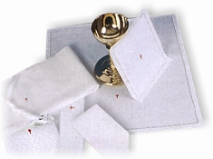
There must always be a corporal spread on the altar before the preparation of the gifts take place. Vessels with consecrated hosts or wine are kept only within the limits of the corporal.

Slide 88
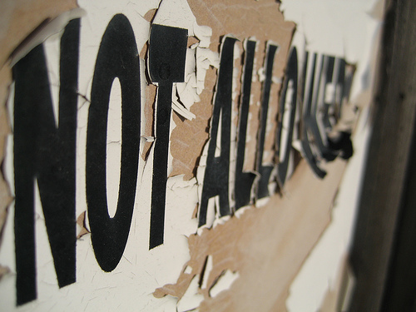
From the very inception even catechumens were not allowed bring gifts to the altar. It was considered the right and the privilege of the baptized community because those who take part in the sacrifice and the banquet are only full-fledged members of the Body of Christ. Hence, non-Christians are not permitted to bring gifts in the offertory procession.

Slide 89
We will take a few ritual moments for our reflection…
讓我們就部份的禮儀作反省…
From the Liturgy of the Eucharist:
The Eucharistic Prayer
Breaking of the Bread
從聖體聖事：
聖體經
擘餅禮

Slide 90
The Eucharistic Prayer
聖體經
Why is it ‘dominated’ by the clergy?
為何只有神父在自言自語?
What are the historical roots of the EP?
聖體經的歷史淵源何在?
What are the theological foundations of the EP?
聖體經有神學根據嗎?

Slide 91
The Eucharistic Prayer
聖體經
Why is it ‘dominated’ by the clergy?
為何只有神父在自言自語?
The Liturgy of the Word is a Ministerial Function. It is a type of a Synagogual liturgy.
因為聖道禮是為牧民的，類似猶太會堂的禮儀。
The Liturgy of the Eucharist is a Presidential Function. It is a type of a Temple sacrfice.
而聖祭禮是為祭獻的，就如昔日在聖殿中祭殺犠牲一樣。

Slide 92
The Historical Roots of the Eucharistic Prayer
聖體經的歷史淵源
The historical root of the Christian EP lies in the BIRKAT Ha MAZON Berakah of the Jewish Liturgy.
基督徒聖體經的根源來自猶太禮儀中的 BIRKAT Ha MAZON Berakah

Slide 93
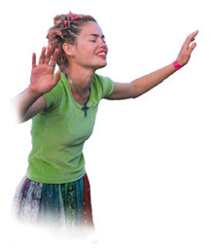
BERAKOTH
The traditional Jews even today break into berakoth; brief praises of God for His benevolence.
傳統的猶太人就是在今日仍會在每天一睜開眼就開始Berakoth以讚頌天主的慈愛。
Berakah is more a Qarban from qarov (near) than Latin offerere.
Berakah是較似Qarban多於拉丁的offerere

Slide 94
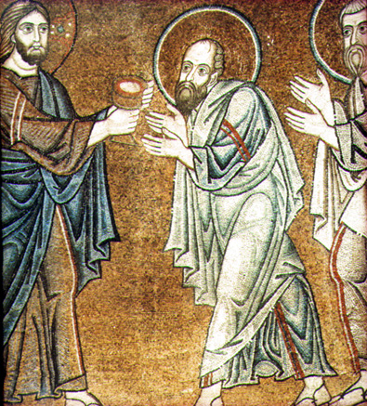
BIRKAT-HA-MAZON
The Birkat-ha-mazon, the
prayer of thanksgiving after the
Cup of Blessing (1 Corinthians 10,16),
or the benediction over food is the oldest and the most important because it alone is expressly commanded in the Torah (Deuteronomy 8,10)
(You shall eat until you are satisfied, and you shall bless Yahweh for the good land he has given you)
Birkat-ha-mazon是在猶太教律中就祝聖感恩之杯及食物時，最古老亦是最重要的感恩禱文。
(你應當為你得到飽飫及所承受的土地感謝雅威)
It is regarded as the source of the Christian Eucharistic Prayer.
這被視為基督徒聖體經的來源。

Slide 95
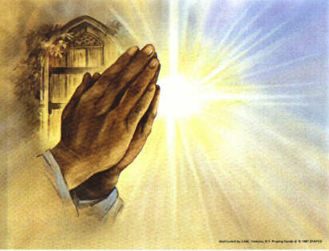
BIRKAT-HA-MOSI
Birkat-ha-mosi, from the root ysh(to go out)(Blessed are you, O Lord, our God, King of the Universe, who brings forth bread from the earth – Psalm 104, 14) is the prayer before meals.
Birkat-ha-mosi(主，我們的天主，宇宙的君王，我們就祢所賜的食物衷心感謝。)是不折不扣的飯前經。

Slide 96
PARTS OF THE BIRKAT-HA-MAZON
Birkat-ha-mazon contains two sections of thanksgiving and one petition
  Birkat-ha-zan – Thanking God for food given to the people of Israel
  Birkat-ha-ares – Thanking God for the good and desirable land
  Birkat Yerusalayim Boneh – A prayer for Jerusalem

Slide 97

L Finkelstein, “The Birkat-ha-mazon”, Jewish Quarterly Review 19(1928-29), 211-262, compares the Birkat-ha-mazon and the Didache(The Teaching of the Twelve Apostles) (Didache was discovered by Archbishop Bryennios who came across the only complete Greek manuscript in Jerusalem in 1875) first published in 1883, probably written in Syria in the first century; author unknown)
In Didache chapter 9 we find a thematic framework similar to that found in the Jewish Birkat-ha-mazon.
    A prayer over the cup
    A prayer over the bread
    A prayer of petition for the Church

Slide 98
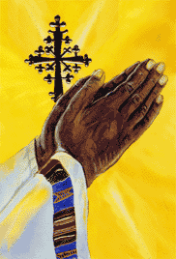
Finkelstein says that The Didache is a Christian text that has transformed the Birkat-ha-mazon into Christian prayer.

Slide 99
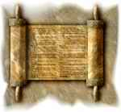
C. Giraudo, “La Struttura Letteraria della Preghiera Eucaristica”, Analecta Biblica 92, Roma 1981, 3. says:
Didache is the Christian Birkat-ha-mazon

Slide 100
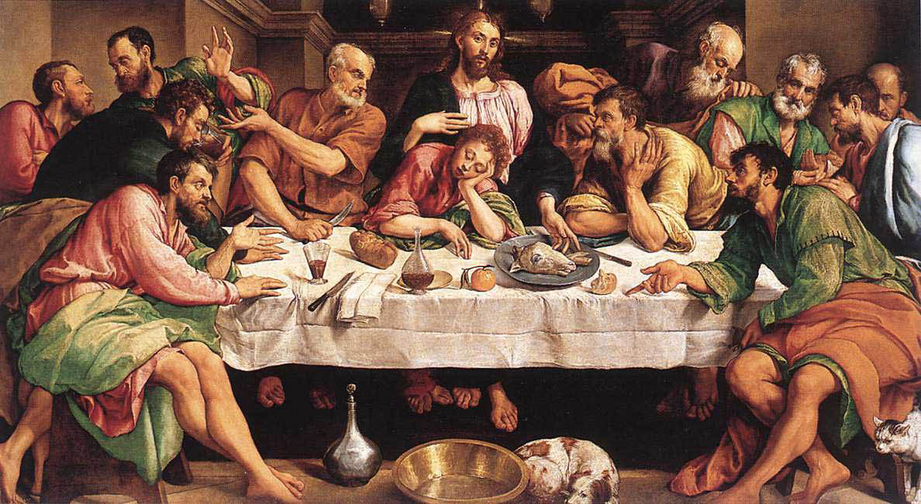
It is Hyppolytus of Rome who is said to have included the theme of Easter Homilies into the Didache setting.
In this manner, the history of salvation and the account of the Last Supper entered into the EP.

Slide 101

The EP is a very special prayer which has
  a Theological content
  a Traditional background
  a Technical aspect
It is NOT some simple prayer that could be meddled with at will.
It is a sacred prayer, the contents of which must very carefully studied in detail and depth.

Slide 102
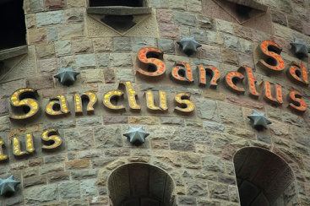
PARTS OF THE ANAPHORA
Preface
  Opening Dialogue
  Affirmation of unceasing praise
  Reasons for praise
  Pre-Sanctus
Sanctus
Post Sanctus (Vere Sanctus)
First Epilcesis(Consecratary)

Slide 103
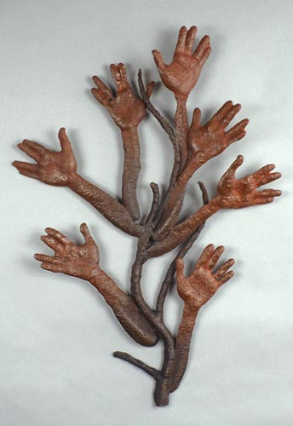
Institution Narrative
Memorial Acclamation
Anamnesis
Offering
Second Epiclesis
Intercessions for the living
and the dead
Communion with the saints
and the hope of eternal life
Doxology
Amen

Slide 104
Theological Basis
Paterological Orientation
Mediation of Christ
Epicletic Action
Paschal Mystery
Anamnesis
Communion of Saints

Slide 105
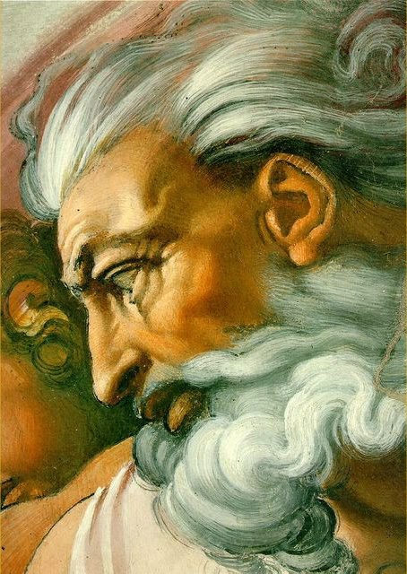
The anaphora is a heavily
Theocentric prayer.
Jesus taught us to praise and pray to the Father.
Even the words of Consecration are theocentric though the genuflections and elevations at those words become Christocentric gestures.
All other gestures are directed to the Father.

Slide 106
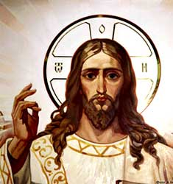
The Anamnesis is Christocentric because we call to mind the Paschal Mystery of Jesus.
It is very rarely we come across EPs addressed to the Son. For example: the Anaphora of Gregory Nazianzus of the late 5th century and the Chaldean anaphora of apostles Addai and Mari.

Slide 107
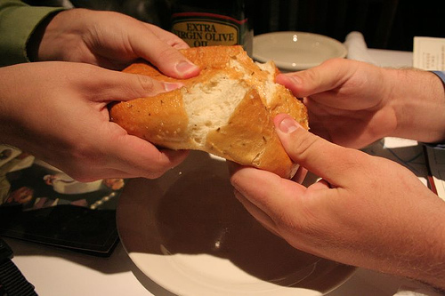

RITUALS OF PEACE, BREAKING OF THE BREAD AND HOLY COMMUNION

Slide 108
RITE OF PEACE
The invitation to peace is placed in the context of the resurrection appearances of Jesus. There are 2 types of Peace greetings: Reconciliatory Peace and Paschal Peace. At this juncture of the Mass what we have is Paschal Peace bidding.
Peace, therefore, is seen not as a human product, but as a gift of the risen Lord.

Slide 109
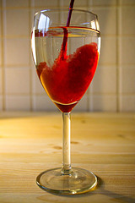
CO-MINGLING
The Co-mingling is an ancient
custom which in the very early
times had three different origins:
  SANCTA
  FERMENTUM
  SEMITIC CONCEPT OF LIFE
The present symbolism
speaks about attaining everlasting life

Slide 110
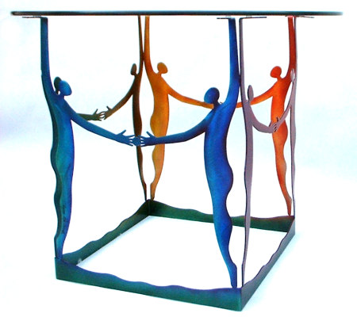
BREAKING OF THE BREAD
This is the third Eucharistic action – BREAKING
Breaking symbolises the nourishment of many with ONE BODY, and ONE CUP.
The way it is done in the Roman Rite does not give the impression that it is major Eucharistic action.
It may be accompanied by the singing of the Agnus Dei
Agnus Dei has a penitential
character

Slide 111

Prayers following the Agnus Dei are personal prayers of the celebrant which have their origin in the Amiens Missal of German origin
The invitation to the banquet is certainly penitential in character because of the historical situation where people came late for the Mass and missed the earlier penitential ritual.
In the early days the priest said: Holy things to the Holy and people replied: Only the Lord is holy.

Slide 112
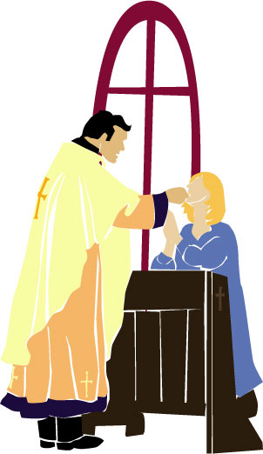
HOLY COMMUNION
Receiving Holy Communion is rich with symbolism:
  We are privileged to sit at the Table of the
  Lord
  We are nourished by the Lord Himself with His
  Body and Blood
  We are all brothers and Sisters because we partake of the same meal at the same table
  We are a people walking towards the eternal banquet of heaven
  Eating at this table is the sign of full Communion in the Church

